Slide 1
Shopping
Conversation Questions

Slide 2
Speak to you partner (Teens)
When did you last go shopping?
What did you buy?
Do you prefer shopping in a supermarket or in a street market?
Which shopping centre do you normally go to?
Which shops do you normally go to in the shopping centre?
What other activities can you do in the shopping centre?

Slide 3
Speak to your partner (Teens)
Do your parents buy meat from the butcher’s or from the supermarket?
Do you parents buy bread and cakes from the baker’s of from the supermarket?
Do you go shopping in the sales? What’s the biggest discount you’ve ever got?
Would you like to work as a shop assistant or manager? Why? Why not? Do you think it’s an easy or difficult job?
Would you buy designer shoes or a handbag from a street market?
Are you a shopaholic?
Have you ever returned an item and got a refund?

Slide 4
Speak to you partner (Adults)
When did you last go shopping?
What did you buy?
Do you prefer shopping in a supermarket or in a street market?
Which shopping centre do you normally go to?
Which shops do you normally go to in the shopping centre?
What other activities can you do in the shopping centre?

Slide 5
Speak to your partner (Adults)
Do you buy meat from the butcher’s or from the supermarket? Why?
Do you buy bread and cakes from the baker’s of from the supermarket?
Do you go shopping in the sales? What’s the biggest discount you’ve ever got?
Would you like to work as a shop assistant or manager? Why? Why not? Do you think it’s an easy or difficult job?
Would you buy designer shoes or a handbag from a street market?
Are you a shopaholic?
Have you ever returned an item and got a refund?

Slide 6
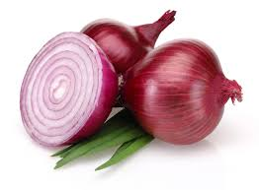
In the corner shop (ELM)
Shop assistant: Hello, good morning.
Customer: Hello, have you got any apples?
Shop assistant: Yes. How many do you want?
Customer: Can I have 6, please?
Shop assistant: Ok, no problem. Anything else?
Customer: Yes please, have you got any onions?
Shop assistant: Yes, how many do you want?
Customer: Can I have 3 please?
Shop assistant: 1, 2, 3, Anything else?
Customer: No, that’s all thanks.

Slide 7
Your shopping list (ELM)
Shop assistant: Hello, how can I help you?
Customer: Hello, have you got any _______?
Shop assistant: Yes, we have. How many do you want?
OR No we haven’t, sorry.
Customer: Can I have ___ (number), please?
Shop assistant: Certainly, here you are. Do you want anything else?
Customer: Yes please, have you got any ________?
Shop assistant: Yes, how many do you want? OR No we haven’t, sorry.
Customer: Can I have ___ (number) please?
Shop assistant: 1, 2, 3, (etc.) Here you are. Anything else?
Customer: No, that’s all thanks.

Slide 8
Memory (ELM)
Shop assistant: Hello, ______ morning.
Customer: Hello, have you _____ any apples?
Shop assistant: Yes. How ______ do you want?
Customer: Can I ______ 6, please?
Shop assistant: Ok, ___ problem. Anything ___?
Customer: Yes please, have ___ got any onions?
Shop assistant: Yes, how many do you _____?
Customer: _____ I have 3 please?
Shop assistant: 1, 2, 3, Anything else?
Customer: No, that’s all _______.

Slide 9
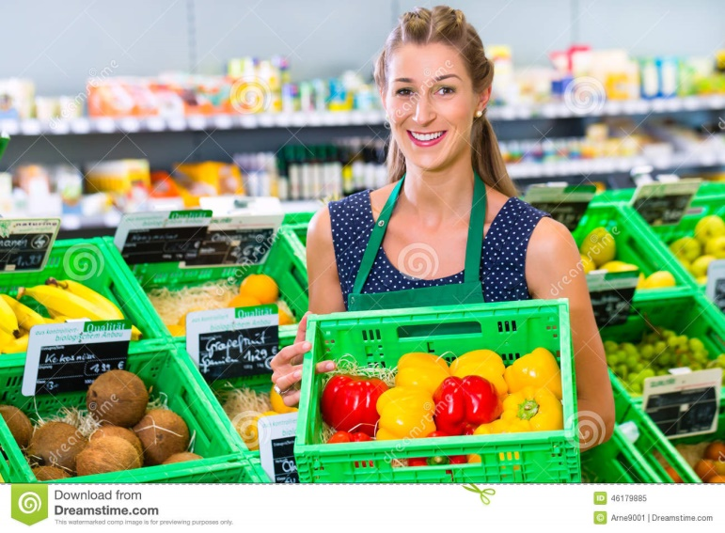
In the corner shop (ELM+)
Shop assistant: Hello, how can I help you?
Customer: Hello, have you got any apples?
Shop assistant: Yes, we have. How many do you want?
Customer: Can I have 6, please?
Shop assistant: Certainly, here you are. Do you want anything else?
Customer: Yes please, have you got any onions?
Shop assistant: Yes, how many do you want?
Customer: Can I have 3 please?
Shop assistant: 1, 2, 3, Here you are. Anything else?
Customer: No, that’s all thanks.

Slide 10
Memory (ELM+)
Shop assistant: Hello, ____ can I help you?
Customer: Hello, have you got ____ apples?
Shop assistant: Yes, we _____. _____ many do you want?
Customer: Can I ______ 6, please?
Shop assistant: Certainly, _____ you are. ____ you want ______ else?
Customer: Yes please, _____ you got any onions?
Shop assistant: Yes, how _____ do you ______?
Customer: _____ I have 3 please?
Shop assistant: 1, 2, 3, Here you _____. Anything ______?
Customer: No, that’s _____ thanks.

Slide 11
Your shopping list (ELM+)
Shop assistant: Hello, how can I help you?
Customer: Hello, have you got any _______?
Shop assistant: Yes, we have. How many do you want?
OR No we haven’t, sorry.
Customer: Can I have ____ (number), please?
Shop assistant: Certainly, here you are. Do you want anything else?
Customer: Yes please, have you got any ________?
Shop assistant: Yes, how many do you want? OR No we haven’t, sorry.
Customer: Can I have ____ (number) please?
Shop assistant: 1, 2, 3, (etc.) Here you are. Anything else?
Customer: No, that’s all thanks.

Slide 12
In the corner shop (Pre-Int)
Shop assistant: Hello, how can I help you?
Customer: Hello, have you got any apples?
Shop assistant: Yes, we have. How many would you like?
Customer: Can I have 6, please?
Shop assistant: Certainly, here you are. Would you like anything else?
Customer: Yes please, have you got any onions?
Shop assistant: Yes, how many would you like?
Customer: Can I have 3 please?
Shop assistant: 1, 2, 3, Here you are. Anything else?
Customer: No, that’s all thanks.

Slide 13
Memory (Pre-Int)
Shop assistant: Hello, ____ can I help you?
Customer: Hello, have you got ____ apples?
Shop assistant: Yes, we _____. _____ many would you like?
Customer: Can I ______ 6, please?
Shop assistant: Certainly, _____ you are. Would you like ______ else?
Customer: Yes please, _____ you got any onions?
Shop assistant: Yes, how _____ would you ______?
Customer: _____ I have 3 please?
Shop assistant: 1, 2, 3, Here you _____. Anything ______?
Customer: No, that’s _____ thanks.

Slide 14
Your shopping list (Pre-Int)
Shop assistant: Hello, how can I help you?
Customer: Hello, have you got any _______?
Shop assistant: Yes, we have. How many would you like?
OR No we haven’t, sorry.
Customer: Can I have ____ (number), please?
Shop assistant: Certainly, here you are. Would you like anything else?
Customer: Yes please, have you got any ________?
Shop assistant: Yes, how many would you like? OR No we haven’t, sorry.
Customer: Can I have ____ (number) please?
Shop assistant: 1, 2, 3, (etc.) Here you are. Anything else?
Customer: No, that’s all thanks.

Slide 15
Debate (Adults/INT+)
Online shopping is better than offline shopping.
For | Against
Opinion | Agree | Disagree
In my opinion, As far as I’m concerned, From my point of view, As I see it, | I couldn’t agree more. You’re absolutely right. I feel the same. | I take your point but… I see what you mean but… You must be joking!

