Slide 1
Talk about the picture. Where do you think is it? What sort of place is it?
Notes:
Based on https://freeenglishlessonplans.com/2018/02/06/c1-c2-holiday-diary-reading-vocabulary/

Slide 2
A clue…do you know which country it is yet?

Slide 3
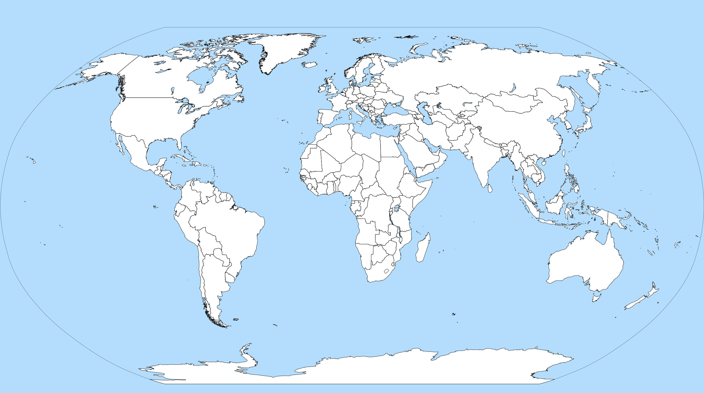
A very big clue… what’s this country called?

Slide 5
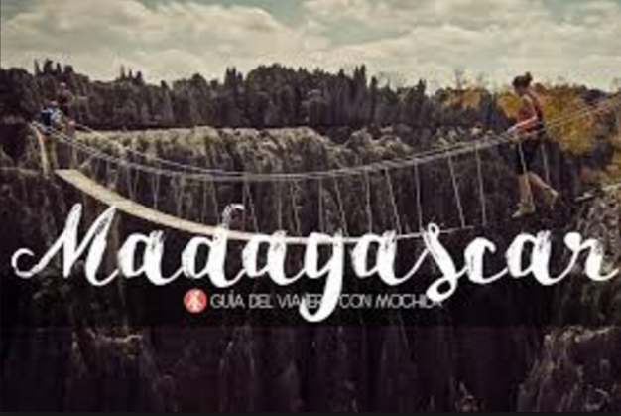
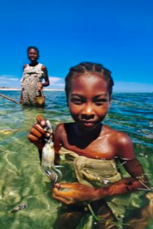
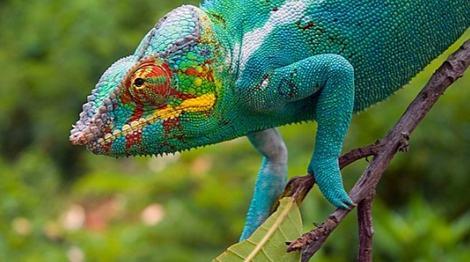
What do you know about Madagascar? Have you ever been there? Would you like to?

Slide 6
Quiz – Madagascar – true or false?
1. It is the world’s second largest island.
2. Its population is over 25 million.
3. It wasn’t discovered until the 1700s.
4. It is one of the happiest places in the world.
5. It is home to 150,000 endemic species
Notes:
https://dictionary.cambridge.org/dictionary/english/endemic

Slide 7
Quiz – Madagascar – true or false?
1. It is the world’s second largest island.
False – It’s the fourth largest island, after Greenland, New guinea, and Borneo.
2. Its population is over 25 million.
True – around 26 million
3. It wasn’t discovered until the 1700s.
False – it was discovered in the 1500s, by a Portuguese explorer.
4. It is one of the happiest places in the world.
False – it is one of the least happy places, maybe due to poverty and low life expectancy.
5. It is home to 150,000 endemic species
True
Notes:
Greenland, New Guinea, Borneo

Slide 8
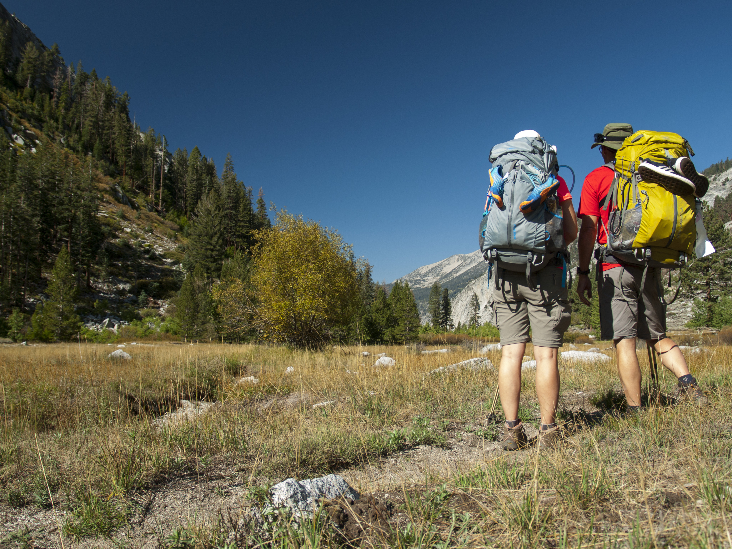
A trip to Madagascar
Jenny and Matt went on a trip to Madagascar. What sort of holiday do you think they had?
Read the text and decide whether they had a good experience overall.

Slide 9
We’re quite adventurous so your standard beach holiday doesn’t really cut it for us so after umming and ahhing for a few months we finally settled on a trip to Madagascar. We had set our sights on exploring the dense undergrowth of Madagascar’s jungles and maybe catching a glimpse of some of its famed wildlife.
We flew into the capital Antananarivo, no sooner had we stepped off the plane than we were hit by a wave of intense heat, Madagascar has a really humid climate so the sweat was pouring down our faces in no time at all. Antananarivo is bustling with life with a mindboggling network of haphazard back streets in which you can lose yourself in the blink of an eye. Apart from the hotel we’d booked online we’d decided to play it by ear for the rest of the trip so we set about looking for a guide to take us into the lush vegetation of the surrounding rainforests. Unfortunately there was a mix-up with our luggage that set us back 2 hours but eventually we picked up our suitcases and set off on our mission.
As a city, Antananarivo isn’t much to write home about. It’s pretty grimy and run-down and our taxi ride into the city centre was rather fraught. When we finally arrived at our hotel it looked a sorry sight - not what we’d been led to believe in the brochure. However, we’re not really big on creature comforts so we didn’t mind. Luckily, the hotel organised guided-tours of the rainforest and there was one leaving the very next day.
We were up at the crack of dawn the next day to board the rickety old minibus that was going to take us out into the middle of nowhere to begin our adventure. The bus journey was a little bit hairy as the road was little more than a track with potholes everywhere. We gradually wound our way up through the mountainous landscape which surrounds the city until we reached the summit of one of the foothills where we stopped for a picnic. The views of the rainforest stretching out in front of us were a real sight to behold. Never before had I seen such an awe-inspiring sight…
https://freeenglishlessonplans.com/2018/02/06/c1-c2-holiday-diary-reading-vocabulary
Notes:
Doesn’t cut it
Umming and ahhing settle on
Set your sights on dense undergrowth catch a glimpse humid climate bustling with life
Mindboggling haphazard the blink of an eye play it by ear set about lush vegetation mix-up set someone back set off

Slide 10
The author likes beach holidays T/F
Antananarivo is a difficult city to navigate around T/F
They had the whole trip planned out beforehand T/F
Their luggage was put on the wrong plane T/F
They liked Antananarivo T/F
The hotel was different to the description in the brochure T/F
They don’t mind roughing it T/F
The journey to the rainforest was relaxing T/F
They were impressed by the views from the foothill T/F
https://freeenglishlessonplans.com/2018/02/06/c1-c2-holiday-diary-reading-vocabulary

Slide 11
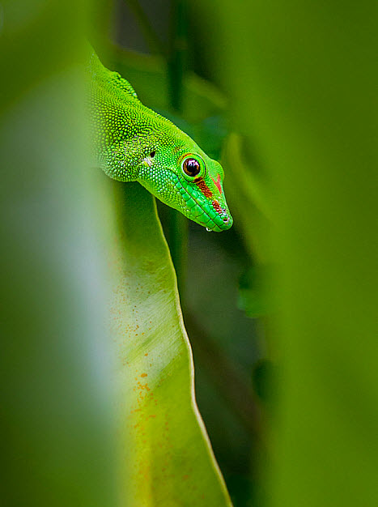
Look at the expressions in bold and discuss their meaning.

Slide 12
We’re quite adventurous so your standard beach holiday doesn’t really cut it for us. After umming and ahhing for a few months we finally settled on a trip to Madagascar. We had set our sights on exploring the dense undergrowth of Madagascar’s jungles and maybe catching a glimpse of some of its famed wildlife.
We flew into the capital Antananarivo, and no sooner had we stepped off the plane than we were hit by a wave of intense heat. Madagascar has a really humid climate so the sweat was pouring down our faces in no time at all. Antananarivo is bustling with life with a mindboggling network of haphazard back streets in which you can lose yourself in the blink of an eye. Apart from the hotel we’d booked online we’d decided to play it by ear for the rest of the trip so we set about looking for a guide to take us into the lush vegetation of the surrounding rainforests. Unfortunately there was a mix-up with our luggage that set us back 2 hours but eventually we picked up our suitcases and set off on our mission.
As a city, Antananarivo isn’t much to write home about. It’s pretty grimy and run-down and our taxi ride into the city centre was pretty fraught. When we finally arrived at our hotel it looked a sorry sight - not what we’d been led to believe in the brochure. However, we’re not really big on creature comforts so we didn’t mind. Luckily, the hotel organised guided tours of the rainforest and there was one leaving the very next day.
We were up at the crack of dawn the next day to board the rickety old minibus that was going to take us out into the middle of nowhere to begin our adventure. The bus journey was a little bit hairy as the road was little more than a track with potholes everywhere. We gradually wound our way up through the mountainous landscape which surrounds the city until we reached the summit of one of the foothills where we stopped for a picnic. The views of the rainforest stretching out in front of us were a real sight to behold. Never before had I seen such an awe-inspiring sight…
Notes:
Doesn’t cut it
Umming and ahhing settle on
Set your sights on dense undergrowth catch a glimpse humid climate bustling with life
Mindboggling haphazard the blink of an eye play it by ear set about lush vegetation mix-up set someone back set off

Slide 13
What can you remember?
Look at the text again, on the next slide. Can you fill in the gaps from memory?

Slide 14
We’re quite adventurous so your standard beach holiday doesn’t really ___ (1) it for us, so after ________(2) and ahhing for a few months we finally settled ______(3) a trip to Madagascar. We had set our ___________(4) on exploring the _________(5) undergrowth of Madagascar’s jungles and maybe catching a ____________(6) of some of its famed wildlife.
We flew into the capital Antananarivo, and no sooner had we stepped off the plane than we were hit by a wave of intense heat. Madagascar has a really humid climate so the sweat was pouring down our faces in no time at all. Antananarivo is ___________(7) with life with a mindboggling network of ________________ (8) back streets in which you can lose yourself in the blink of an eye. Apart from the hotel we’d booked online we’d decided to play it by ________(9) for the rest of the trip so we set __________(10) looking for a guide to take us into the ___________(11) vegetation of the surrounding rainforests. Unfortunately there was a _________(12) with our luggage that set us _________(13) two hours but eventually we picked up our suitcases and set off on our mission.
As a city, Antananarivo isn’t much to write home about. It’s pretty ________(14) and run-down and our taxi ride into the city centre was rather fraught. When we finally arrived at our hotel it looked a ________ (15) sight, not what we’d been __________(16) to believe in the brochure. However, we’re not really big on creature ______________(17) so we didn’t mind. Luckily, the hotel organised guided-tours of the rainforest and there was one leaving the very next day.
We were up at the ____________(18) of dawn the next day to board the rickety old minibus that was going to take us out into the ____________(19) of nowhere to begin our adventure. The bus journey was a little bit __________(20) as the road was little more than a track with potholes everywhere. We gradually wound our way up through the mountainous landscape which surrounds the city until we reached the summit of one of the foothills where we stopped for a picnic. The views of the rainforest stretching out in front of us were a real sight to ________(21) never before have I seen such an awe-______________(22) sight…
https://freeenglishlessonplans.com/2018/02/06/c1-c2-holiday-diary-reading-vocabulary

Slide 15
Homework
Write a text about a trip you have taken in the past. Include as many of the phrasal verbs as possible.

